Slide 1
Python Programming
Unit 2: Collections & Functions

Slide 2
Strings
Python treats strings as contiguous series of characters delimited by single, double or even triple quotes. Python has a built-in string class named "str" that has many useful features. We can simultaneously declare and define a string by creating a variable of string type. This can be done in several ways which are as follows:
name = "India" graduate = 'N' country = name nationality = str("Indian")
Indexing: Individual characters in a string are accessed using the subscript ([ ]) operator. The expression in brackets is called an index. The index specifies a member of an ordered set and in this case it specifies the character we want to access from the given set of characters in the string.
The index of the first character is 0 and that of the last character is n-1 where n is the number of characters in the string. If you try to exceed the bounds (below 0 or above n-1), then an error is raised.

Slide 3
Strings
Traversing a String: A string can be traversed by accessing character(s) from one index to another. For example, the following program uses indexing to traverse a string from first character to the last.
Example:

Slide 4
Concatenating, Appending and Multiplying Strings
Examples:

Slide 5
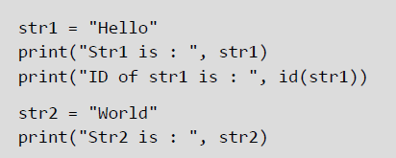
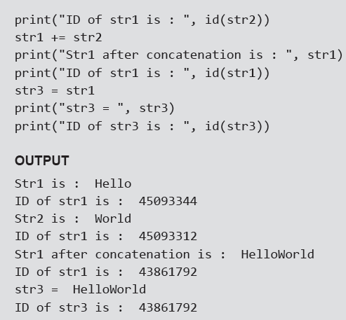
Strings are Immutable
Python strings are immutable which means that once created they cannot be changed. Whenever you try to modify an existing string variable, a new string is created.
Example:

Slide 6
String Formatting Operator
The % operator takes a format string on the left (that has %d, %s, etc) and the corresponding values in a tuple (will be discussed in subsequent chapter) on the right. The format operator, % allow users to construct strings, replacing parts of the strings with the data stored in variables. The syntax for the string formatting operation is:
"<Format>" % (<Values>)
Example:

Slide 7
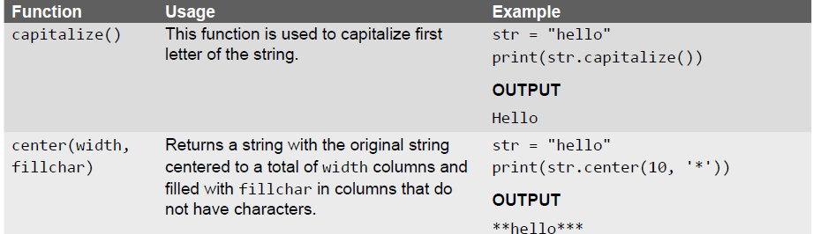
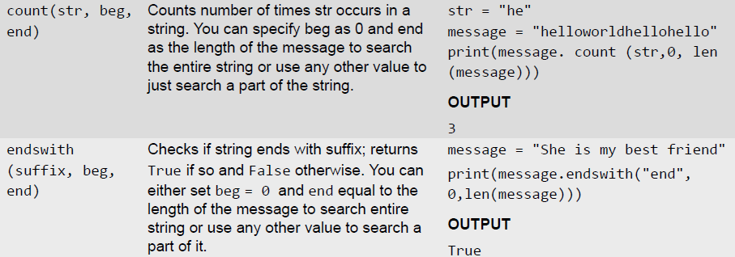
Built-in String Methods and Functions

Slide 8
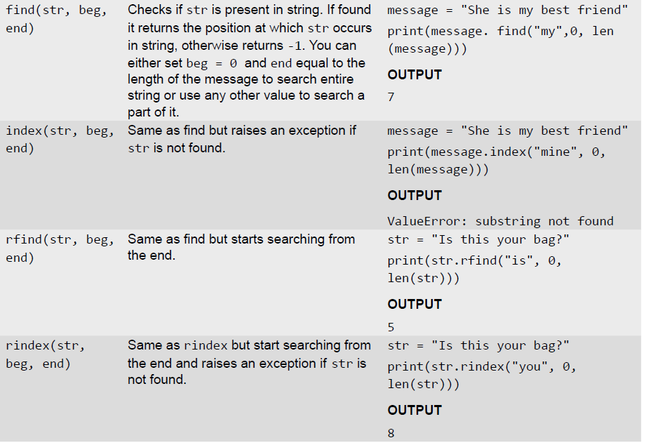
Built-in String Methods and Functions

Slide 9
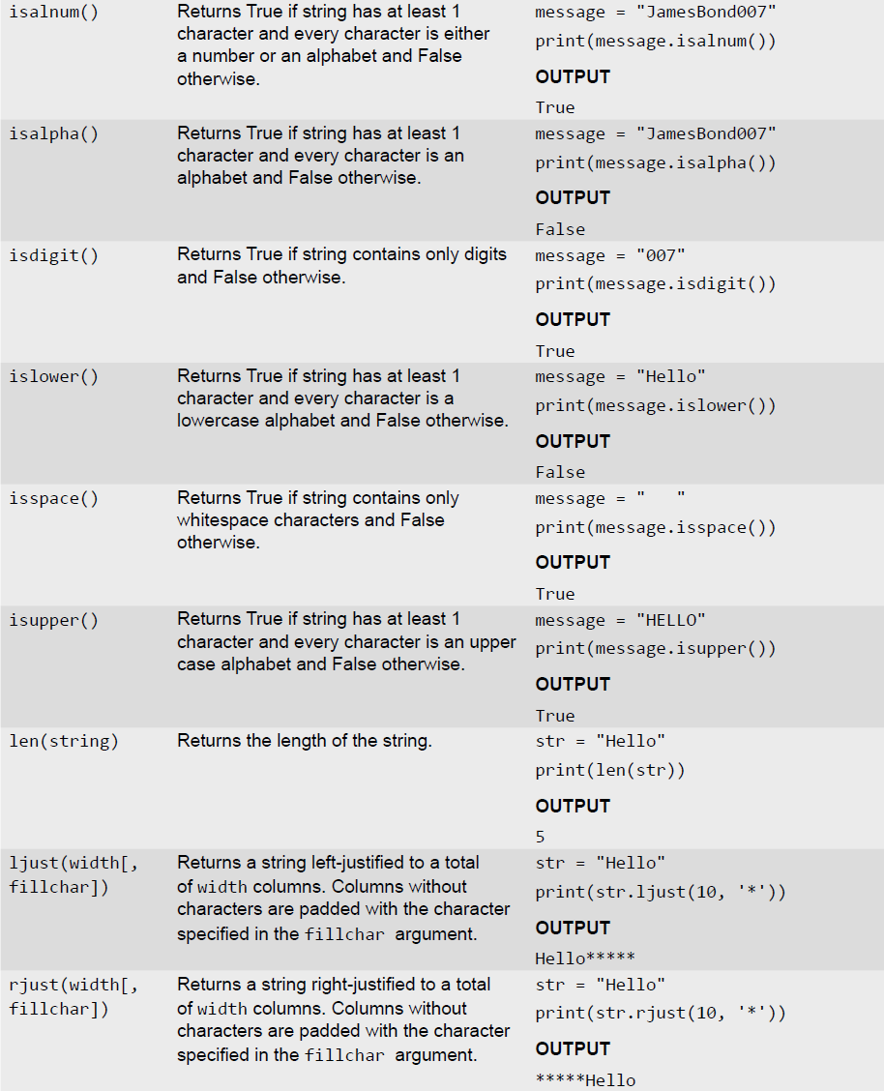
Built-in String Methods and Functions

Slide 10
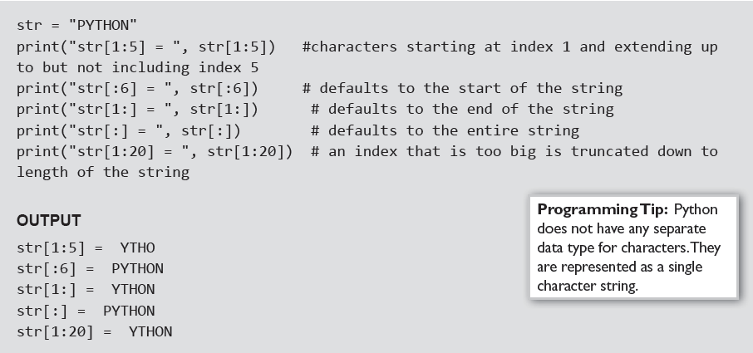
Slice Operation
A substring of a string is called a slice. The slice operation is used to refer to sub-parts of sequences and strings. You can take subset of string from original string by using [ ] operator also known as slicing operator.
Examples:

Slide 11
Specifying Stride while Slicing Strings
In the slice operation, you can specify a third argument as the stride, which refers to the number of characters to move forward after the first character is retrieved from the string. By default the value of stride is 1, so in all the above examples where he had not specified the stride, it used the value of 1 which means that every character between two index numbers is retrieved.
Examples:

Slide 12
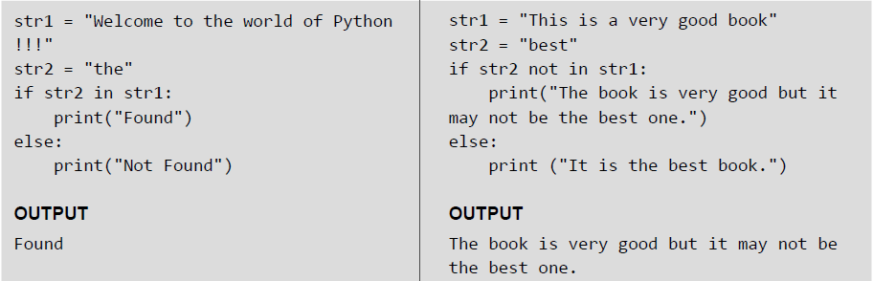
ord() and chr() Functions
ord() function returns the ASCII code of the character and chr() function returns character represented by a ASCII number.
Examples:
in and not in Operators
in and not in operators can be used with strings to determine whether a string is present in another string. Therefore, the in and not in operator are also known as membership operators.
Examples:

Slide 13
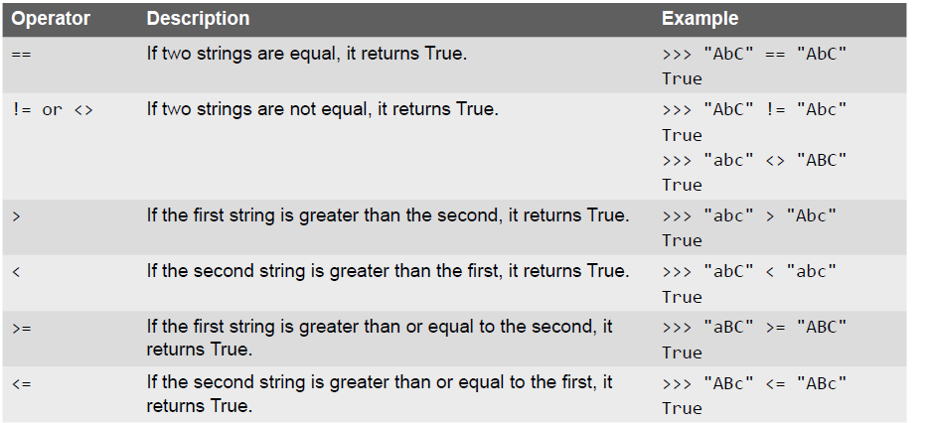
Comparing Strings

Slide 14
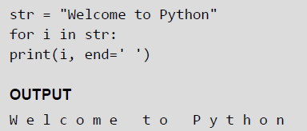
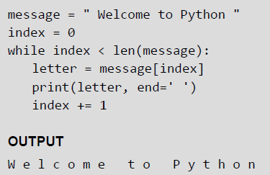
Iterating String
String is a sequence type (sequence of characters). You can iterate through the string using for loop.
Examples:

Slide 15
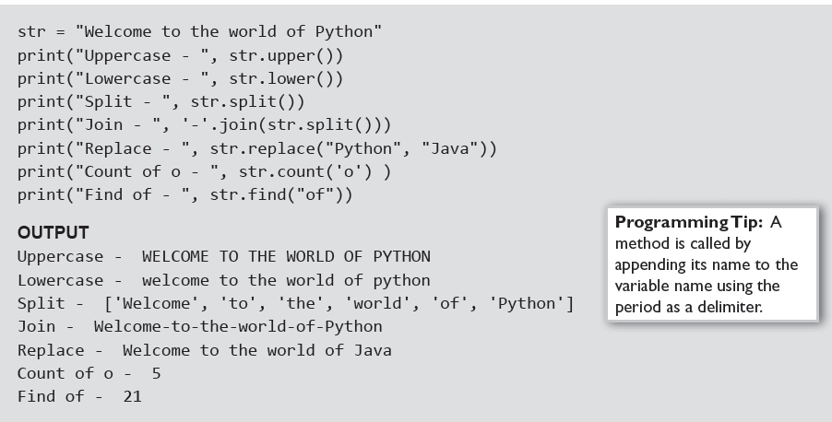
The String Module
The string module consist of a number of useful constants, classes and functions (some of which are deprecated). These functions are used to manipulate strings.
Examples:

Slide 16
Working with Constants in String Module
You can use the constants defined in the string module along with the find function to classify characters. For example, if find(lowercase, ch) returns a value except -1, then it means that ch must be a lowercase character. An alternate way to do the same job is to use the in operator or even the comparison operation.
Examples:

Slide 17
Lists
List is a versatile data type available in Python. It is a sequence in which elements are written as a list of
comma-separated values (items) between square brackets. The key feature of a list is that it can have elements that belong to different data types. The syntax of defining a list can be given as,
List_variable = [val1, val2,...]
Examples:

Slide 18
Access Values in Lists
Similar to strings, lists can also be sliced and concatenated. To access values in lists, square brackets are used to slice along with the index or indices to get value stored at that index. The syntax for the slice operation is given as, seq = List[start:stop:step]
Example:

Slide 19
Updating Values in Lists
Once created, one or more elements of a list can be easily updated by giving the slice on the left-hand side of the assignment operator. You can also append new values in the list and remove existing value(s) from the list using the append() method and del statement respectively.
Example:

Slide 20
Nested Lists
Nested list means a list within another list. We have already said that a list has elements of different data types which can include even a list.
Example:

Slide 21
Cloning Lists
If you want to modify a list and also keep a copy of the original list, then you should create a separate copy of the list (not just the reference). This process is called cloning. The slice operation is used to clone a list.
Example:

Slide 22
Basic List Operations

Slide 23
List Methods

Slide 24
List Comprehensions
Python also supports computed lists called list comprehensions having the following syntax.
List = [expression for variable in sequence]
Where, the expression is evaluated once, for every item in the sequence.
List comprehensions help programmers to create lists in a concise way. This is mainly beneficial to make new lists where each element is the obtained by applying some operations to each member of another sequence or iterable. List comprehension is also used to create a subsequence of those elements that satisfy a certain condition.
Example:

Slide 25
Looping in Lists
Python's for and in constructs are extremely useful especially when working with lists. The for var in list statement is an easy way to access each element in a list (or any other sequence). For example, in the
following code, the for loop is used to access each item in the list.
for i in list:
print(i)
Example:

Slide 26
Using the enumerate() and range() Functions
enumerate() function is used when you want to print both index as well as an item in the list. The function returns an enumerate object which contains the index and value of all the items of the list as a tuple.
The range() function is used when you need to print index.
Examples:

Slide 27
Using an Iterator
You can create an iterator using the built-in iter() function. The iterator is used to loop over the elements of the list. For this, the iterator fetches the value and then automatically points to the next element in the list when it is used with the next() method.
Example:

Slide 28
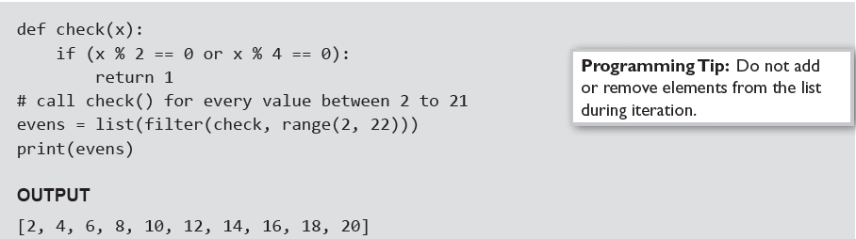
filter() Function
The filter() function constructs a list from those elements of the list for which a function returns True. The
syntax of the filter() function is given as, filter(function, sequence)
As per the syntax, the filter() function returns a sequence that contains items from the sequence for which the function is True. If sequence is a string, Unicode, or a tuple, then the result will be of the same type;
otherwise, it is always a list.
Example:

Slide 29

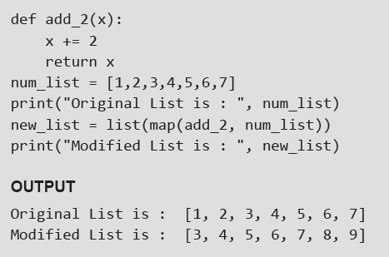
map() Function
The map() function applies a particular function to every element of a list. Its syntax is same as the filter function
After applying the specified function on the sequence, the map() function returns the modified list. The map() function calls function(item) for each item in the sequence and returns a list of the return values.
Example: Program that adds 2 to every value in the list

Slide 30

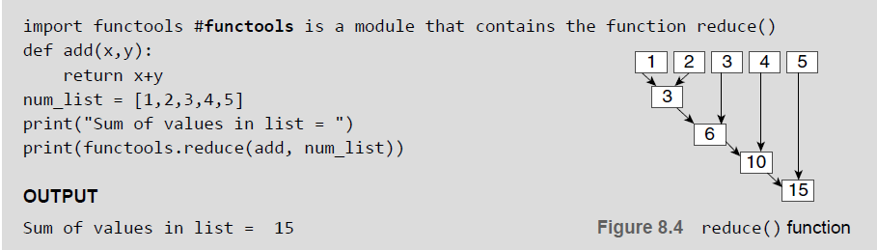
reduce() Function
The reduce() function with syntax as given below returns a single value generated by calling the function
on the first two items of the sequence, then on the result and the next item, and so on.
Example: Program to calculate the sum of values in a list using the reduce() function

Slide 31
Tuple
Like lists, tuple is another data structure supported by Python. It is very similar to lists but differs in two things.
• First, a tuple is a sequence of immutable objects. This means that while you can change the value of one or more items in a list, you cannot change the values in a tuple.
• Second, tuples use parentheses to define its elements whereas lists use square brackets.
Creating Tuple
Creating a tuple is very simple and almost similar to creating a list. For creating a tuple, generally you need to just put the different comma-separated values within a parentheses as shown below.
Tup1 = (val 1, val 2,...)
where val (or values) can be an integer, a floating number, a character, or a string.

Slide 32
Utility of Tuples
In real-world applications, tuples are extremely useful for representing records or structures as we call
in other programming languages. These structures store related information about a subject together.
The information belongs to different data types.
For example, a tuple that stores information about a student can have elements like roll_no, name, course, total marks, avg, etc. Some built-in functions return a tuple. For example, the divmod() function returns two values—quotient as well as the remainder after performing the divide operation.
Examples:

Slide 33
Accessing Values in a Tuple
Like other sequences (strings and lists) covered so far, indices in a tuple also starts at 0. You can even perform
operations like slice, concatenate, etc. on a tuple. For example, to access values in tuple, slice operation is used along with the index or indices to obtain value stored at that index
Example:

Slide 34
Deleting Elements in Tuple
Since tuple is an immutable data structure, you cannot delete value(s) from it. Of course, you can create a new tuple that has all elements in your tuple except the ones you don't want (those you wanted to be deleted).
Examples:

Slide 35
Basic Tuple Operations

Slide 36
Tuple Assignment
Tuple assignment is a very powerful feature in Python. It allows a tuple of variables on the left side of the assignment operator to be assigned values from a tuple given on the right side of the assignment operator.
Each value is assigned to its respective variable. In case, an expression is specified on the right side of the assignment operator, first that expression is evaluated and then assignment is done.
Example:

Slide 37
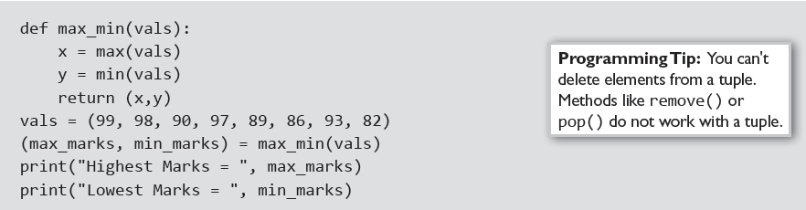
Tuples for Returning Multiple Values and Nested Tuples
Examples:

Slide 38
Checking the Index: index() method
The index of an element in the tuple can be obtained by using the index() method. If the element being searched is not present in the list, then error is generated. The syntax of index() is given as, list.index(obj) where, obj is the object to be found out.
Examples:

Slide 39
count()Method and List Comprehension and Tuples
Examples:

Slide 40
Variable-length Argument Tuples
Many built-in functions like max(), min(), sum(), etc. use variable-length arguments since these functions themselves do not know how many arguments will be passed to them. It allows a function to accept a variable (different) number of arguments. This is especially useful in defining functions that are applicable to a large variety of arguments. For example, if you have a function that displays all the parameters passed to it, then even the function does not know how many values it will be passed. In such cases, we use a variable-length argument that begins with a '*' symbol. Any argument that starts with a '*' symbol is known as gather and specifies a variable-length argument.
Example:

Slide 41
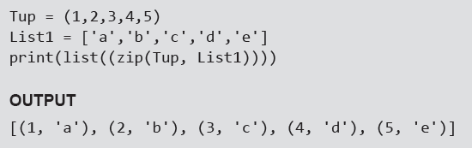
The zip() Function
The zip() is a built-in function that takes two or more sequences and "zips" them into a list of tuples. The tuple thus, formed has one element from each sequence.
Example: Program to show the use of zip() function

Slide 42
Advantages of Tuple over List
• Tuples are used to store values of different data types. Lists can however, store data of similar data types.
• Since tuples are immutable, iterating through tuples is faster than iterating over a list. This means that a
tuple performs better than a list.
• Tuples can be used as key for a dictionary but lists cannot be used as keys.
• Tuples are best suited for storing data that is write-protected.
• Tuples can be used in place of lists where the number of values is known and small.
• If you are passing a tuple as an argument to a function, then the potential for unexpected behavior due to
aliasing gets reduced.
• Multiple values from a function can be returned using a tuple.
• Tuples are used to format strings.

Slide 43


Sets
Sets is another data structure supported by Python. Basically, sets are same as lists but with a difference that sets are lists with no duplicate entries. Technically, a set is a mutable and an unordered collection of items. This means that we can easily add or remove items from it.
A set is created by placing all the elements inside curly brackets {}, separated by comma or by using the
built-in function set(). The syntax of creating a set can be given as,
Example: To create a set, you can write,

Slide 44
Set Operations

Slide 45
Set Operations

Slide 46
Set Operations

Slide 47
Set Operations

Slide 48
Dictionaries
Dictionary is a data structure in which we store values as a pair of key and value. Each key is separated from its value by a colon (:), and consecutive items are separated by commas. The entire items in a dictionary are enclosed in curly brackets({}). The syntax for defining a dictionary is
dictionary_name = {key_1: value_1, key_2: value_2, key_3: value_3}
If there are many keys and values in dictionaries, then we can also write just one key-value pair on a line
to make the code easier to read and understand. This is shown below.
dictionary_name = {key_1: value_1, key_2: value_2, key_3: value_3, ….}
Example:

Slide 49
Accessing Values
Example:

Slide 50
Adding and Modifying an Item in a Dictionary
Example:

Slide 51
Modifying an Entry
Example:

Slide 52
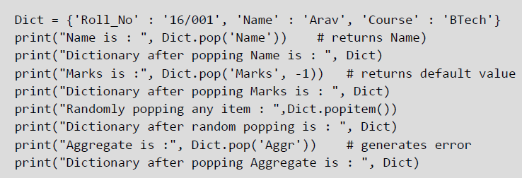
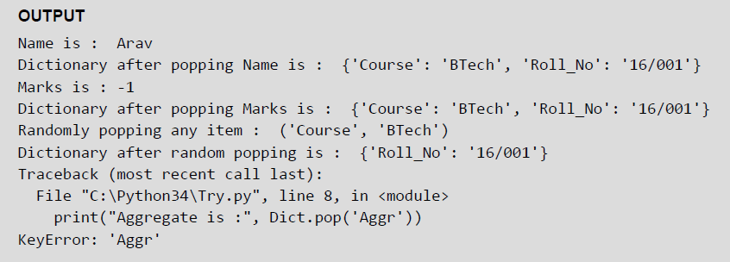
Deleting Items
You can delete one or more items using the del keyword. To delete or remove all the items in just one statement, use the clear() function. Finally, to remove an entire dictionary from the memory, we can gain
use the del statement as del Dict_name. The syntax to use the del statement can be given as,
del dictionary_variable[key]
Example:

Slide 53
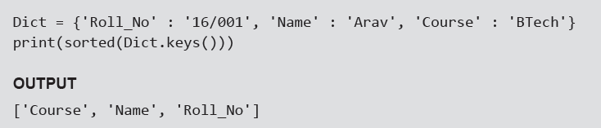
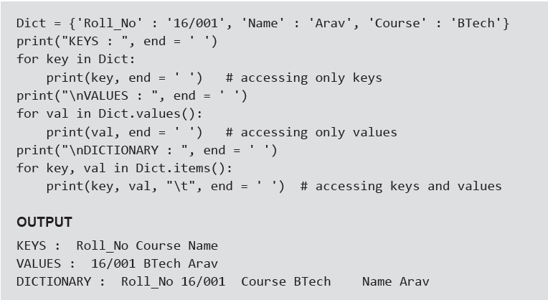
Sorting Items and Looping over Items in a Dictinonary
Examples:

Slide 54
Nested Dictionaries
Example:

Slide 55
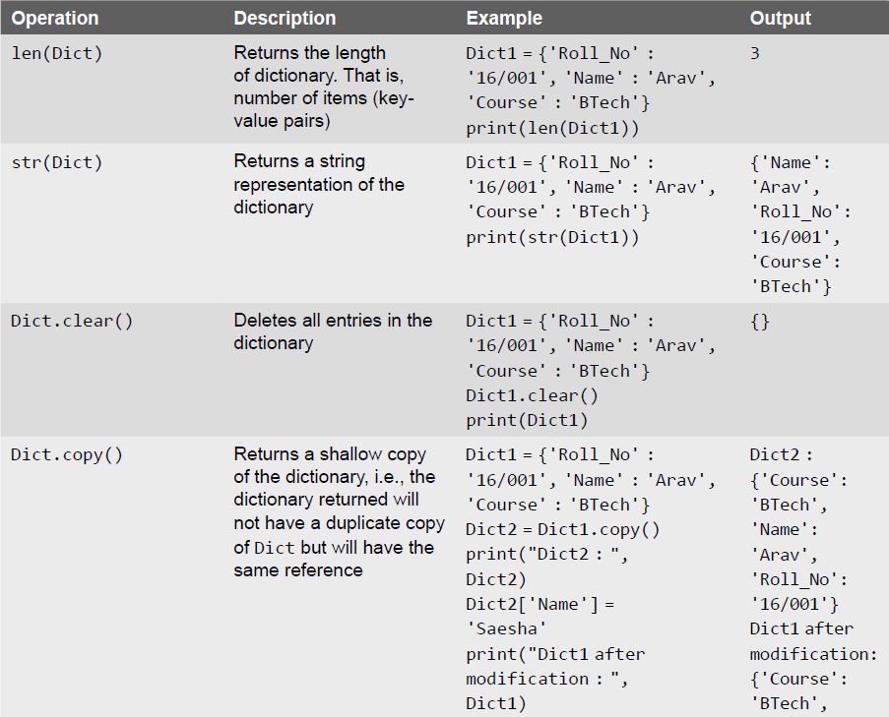
Built-in Dictionary Functions and Methods

Slide 56
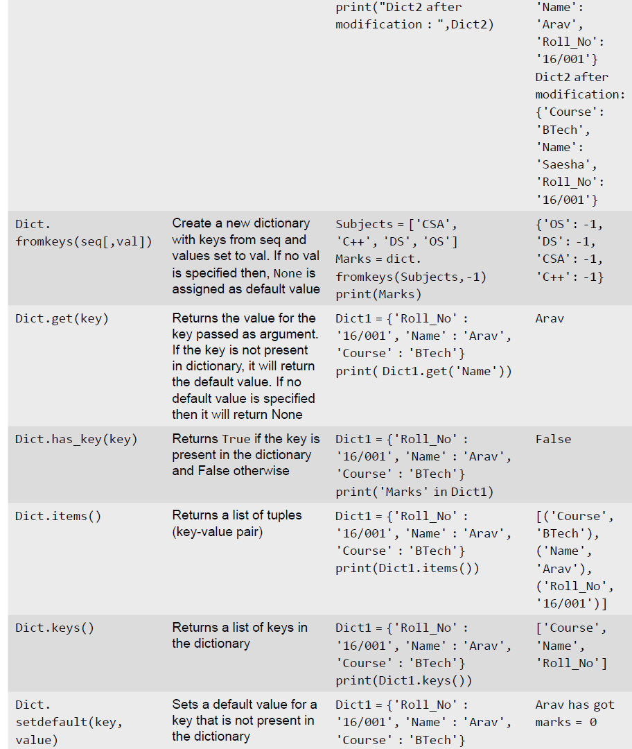
Built-in Dictionary Functions and Methods

Slide 57
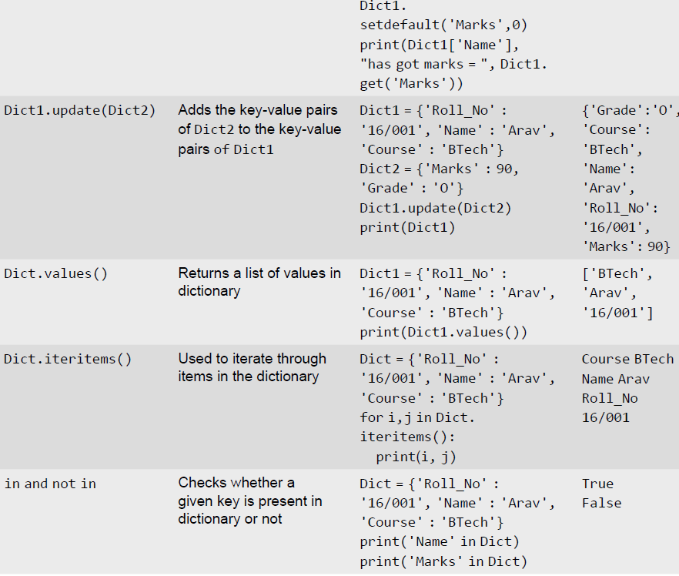
Built-in Dictionary Functions and Methods

Slide 58
Difference between a List and a Dictionary
First, a list is an ordered set of items. But, a dictionary is a data structure that is used for matching one item
(key) with another (value).
• Second, in lists, you can use indexing to access a particular item. But, these indexes should be a number. In
dictionaries, you can use any type (immutable) of value as an index. For example, when we write Dict['Name'], Name acts as an index but it is not a number but a string.
• Third, lists are used to look up a value whereas a dictionary is used to take one value and look up another
value. For this reason, dictionary is also known as a lookup table.
Fourth, the key-value pair may not be displayed in the order in which it was specified while defining the
dictionary. This is because Python uses complex algorithms (called hashing) to provide fast access to the items stored in the dictionary. This also makes dictionary preferable to use over a list of tuples.

Slide 59
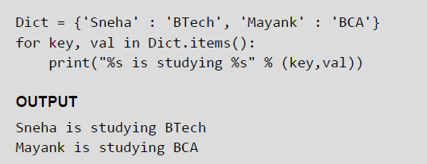
String Formatting with Dictionaries
Python also allows you to use string formatting feature with dictionaries. So you can use %s, %d, %f, etc. to
represent string, integer, floating point number, or any other data.
Example: Program that uses string formatting feature to print the key-value pairs stored in the dictionary

Slide 60
When to use which Data Structure?
• Use lists to store a collection of data that does not need random access.
• Use lists if the data has to be modified frequently.
• Use a set if you want to ensure that every element in the data structure must be unique.
• Use tuples when you want that your data should not be altered.

Slide 61
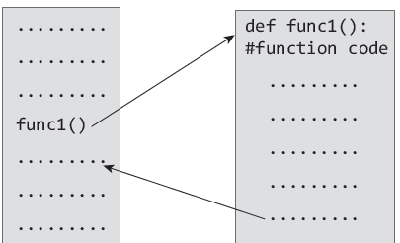
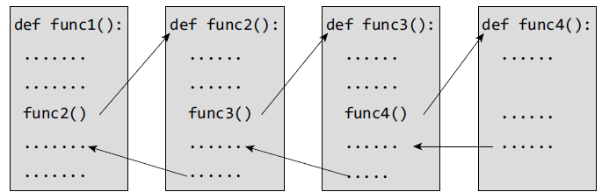
Functions
Python enables its programmers to break up a program into segments commonly known as functions, each of which can be written more or less independently of the others. Every function in the program is supposed to perform a well-defined task.

Slide 62
Need for Functions
Each function to be written and tested separately.
• Understanding, coding and testing multiple separate functions is far easier.
Without the use of any function, then there will be countless lines in the code and maintaining it will be a big mess.
• Programmers use functions without worrying about their code details. This speeds up program development, by allowing the programmer to concentrate only on the code that he has to write.
Different programmers working on that project can divide the workload by writing different functions.
• Like Python libraries, programmers can also make their functions and use them from different point in the main program or any other program that needs its functionalities.

Slide 63
Function Declaration and Definition
• A function, f that uses another function g, is known as the calling function and g is known as the called function.
• The inputs that the function takes are known as arguments/parameters.
• When a called function returns some result back to the calling function, it is said to return that result.
• The calling function may or may not pass parameters to the called function. If the called function accepts arguments, the calling function will pass parameters, else not.
• Function declaration is a declaration statement that identifies a function with its name, a list of arguments that it accepts and the type of data it returns.
• Function definition consists of a function header that identifies the function, followed by the body of the function containing the executable code for that function.

Slide 64
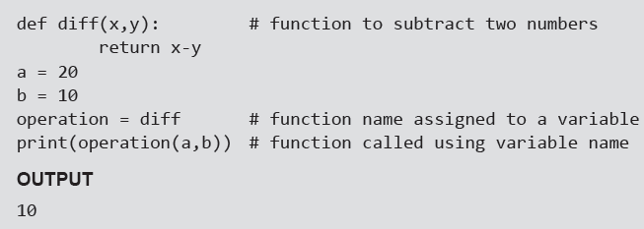
Function Definition
Function blocks starts with the keyword def.
• The keyword is followed by the function name and parentheses (( )).
• After the parentheses a colon (:) is placed.
• Parameters or arguments that the function accept are placed within parentheses.
• The first statement of a function can be an optional statement - the docstring describe what the function does.
• The code block within the function is properly indented to form the block code.
• A function may have a return[expression] statement. That is, the return statement is optional.
• You can assign the function name to a variable. Doing this will allow you to call same function using the name of that variable.
Example:

Slide 65
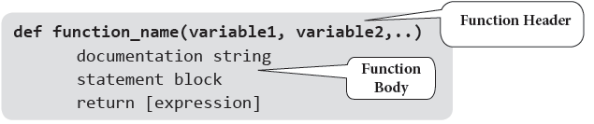
Function Call
The function call statement invokes the function. When a function is invoked the program control jumps to the called function to execute the statements that are a part of that function. Once the called function is executed, the program control passes back to the calling function.
Function Parameters
A function can take parameters which are nothing but some values that are passed to it so that the function can manipulate them to produce the desired result. These parameters are normal variables with a small difference that the values of these variables are defined (initialized) when we call the function and are then passed to the function.
Function name and the number and type of arguments in the function call must be same as that given in the function definition.
If the data type of the argument passed does not matches with that expected in function then an error is generated.
Example:

Slide 66
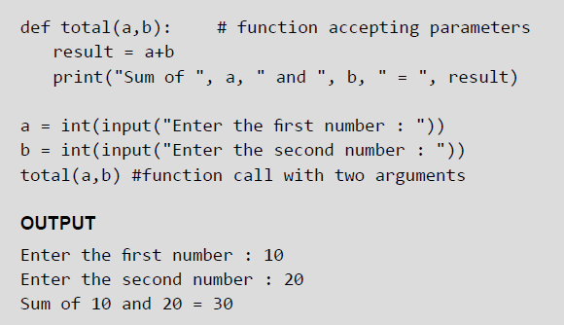
Examples

Slide 67
Local and Global Variables
A variable which is defined within a function is local to that function. A local variable can be accessed from the point of its definition until the end of the function in which it is defined. It exists as long as the function is executing. Function parameters behave like local variables in the function. Moreover, whenever we use the assignment operator (=) inside a function, a new local variable is created.
Global variables are those variables which are defined in the main body of the program file. They are visible throughout the program file. As a good programming habit, you must try to avoid the use of global variables because they may get altered by mistake and then result in erroneous output.

Slide 68
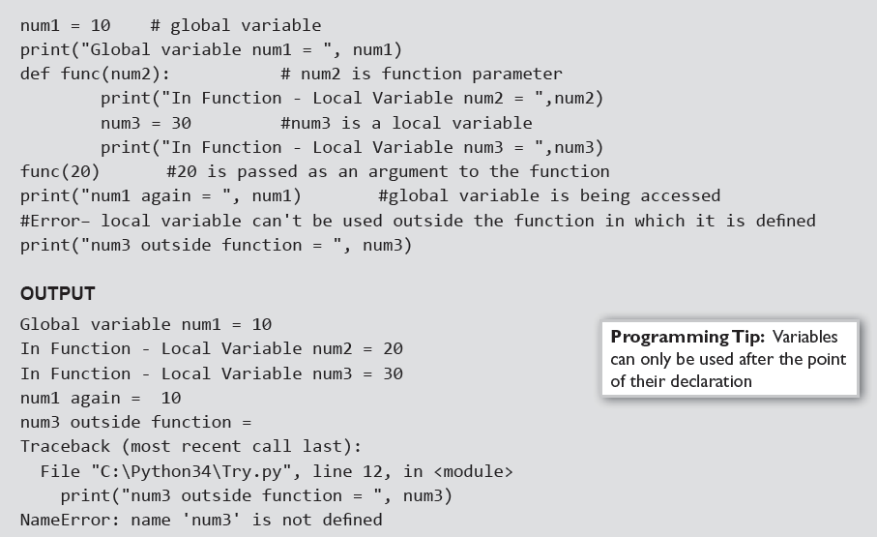
Local and Global Variables
Example:

Slide 69
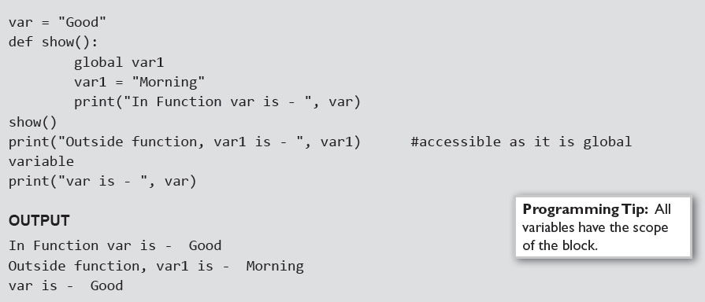
Using the Global Statement
To define a variable defined inside a function as global, you must use the global statement. This declares the local or the inner variable of the function to have module scope.
Example:

Slide 70
Resolution of names
Scope defines the visibility of a name within a block. If a local variable is defined in a block, its scope is that particular block. If it is defined in a function, then its scope is all blocks within that function.
When a variable name is used in a code block, it is resolved using the nearest enclosing scope. If no variable of that name is found, then a NameError is raised. In the code given below, str is a global string because it has been defined before calling the function.
Example:

Slide 71
The Return Statement
The syntax of return statement is,
return [expression]
The expression is written in brackets because it is optional. If the expression is present, it is evaluated and the resultant value is returned to the calling function. However, if no expression is specified then the function will return None.
The return statement is used for two things.
• Return a value to the caller
• To end and exit a function and go back to its caller
Example:

Slide 72
Required Arguments
In the required arguments, the arguments are passed to a function in correct positional order. Also, the number of arguments in the function call should exactly match with the number of arguments specified in the function definition
Examples:

Slide 73
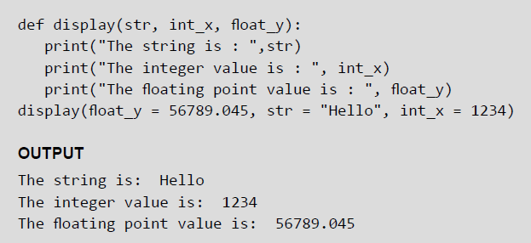
Keyword Arguments
When we call a function with some values, the values are assigned to the arguments based on their position. Python also allow functions to be called using keyword arguments in which the order (or position) of the arguments can be changed. The values are not assigned to arguments according to their position but based on their name (or keyword).
Keyword arguments are beneficial in two cases.
• First, if you skip arguments.
• Second, if in the function call you change the order of parameters.
Example:

Slide 74

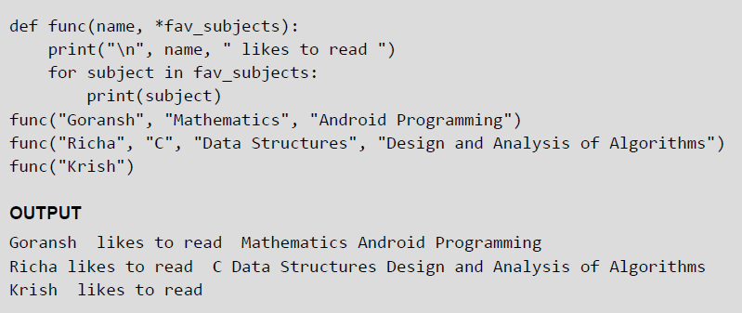
Variable-length Arguments
In some situations, it is not known in advance how many arguments will be passed to a function. In such cases, Python allows programmers to make function calls with arbitrary (or any) number of arguments.
When we use arbitrary arguments or variable length arguments, then the function definition use an asterisk (*) before the parameter name. The syntax for a function using variable arguments can be given as,
Example:

Slide 75
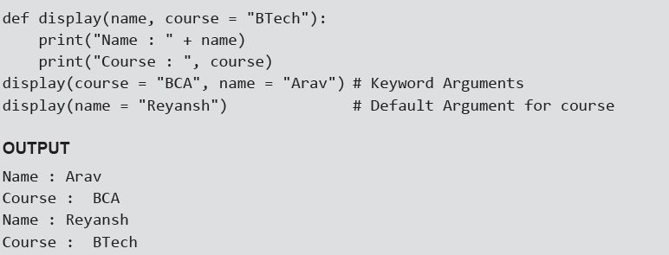
Default Arguments
Python allows users to specify function arguments that can have default values. This means that a function can be called with fewer arguments than it is defined to have. That is, if the function accepts three parameters, but function call provides only two arguments, then the third parameter will be assigned the default (already specified) value.
The default value to an argument is provided by using the assignment operator (=). Users can specify a
default value for one or more arguments.
Example:

Slide 76
Lambda Functions Or Anonymous Functions
Lambda or anonymous functions are so called because they are not declared as other functions using the def keyword. Rather, they are created using the lambda keyword. Lambda functions are throw-away functions, i.e. they are just needed where they have been created and can be used anywhere a function is required. The lambda feature was added to Python due to the demand from LISP programmers.
Lambda functions contain only a single line. Its syntax can be given as,
Example:

Slide 77
Documentation Strings
Docstrings (documentation strings) serve the same purpose as that of comments, as they are designed to explain code. However, they are more specific and have a proper syntax.
Example:

Slide 78
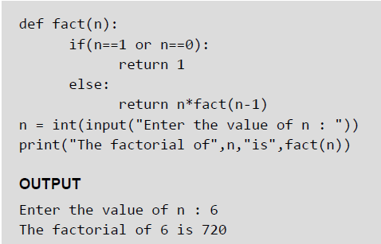
Recursive Functions
A recursive function is defined as a function that calls itself to solve a smaller version of its task until a final call is made which does not require a call to itself. Every recursive solution has two major cases, which are as follows:
• base case, in which the problem is simple enough to be solved directly without making any further calls to the same function.
• recursive case, in which first the problem at hand is divided into simpler sub parts.
Recursion utilized divide and conquer technique of problem solving.
Example:

